Slide 1
Working with the Web Part Property Pane
Introducing the Property Pane
Notes:
To watch a recorded presentation of this lesion:
https://www.youtube.com/watch?v=4QLY6z3RGug

Slide 2

Introducing the Property Pane
Overview of Web Part property pane
Implementing custom properties

Slide 3
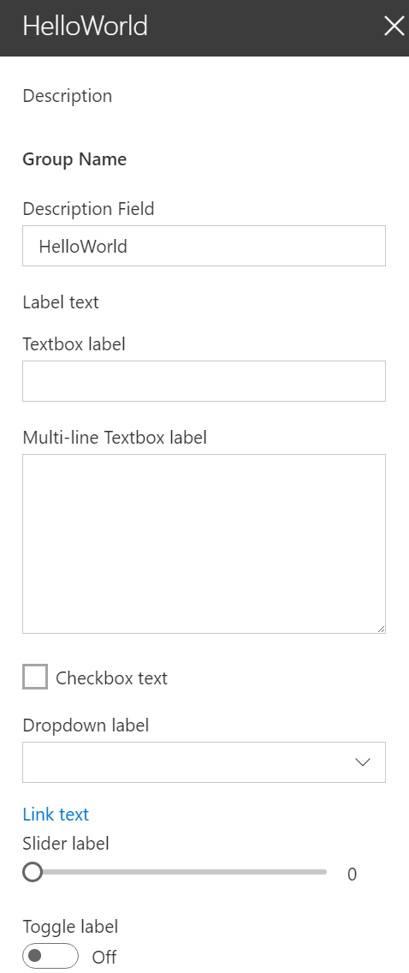
Overview
The property pane has three key elements
Pages, Headers, Groups
Property panes must contain a page and at least one group, the header is optional
The property pane supports the following field types
Label
Textbox
Multi-line Textbox
Checkbox
Dropdown
Link
Slider
Toggle
Custom
Notes:
Pages: Separate pages in a single property pane. Pages contain a Header and Groups.
Headers: The title of the property pane
Groups: Sections in the property pane that group properties

Slide 4
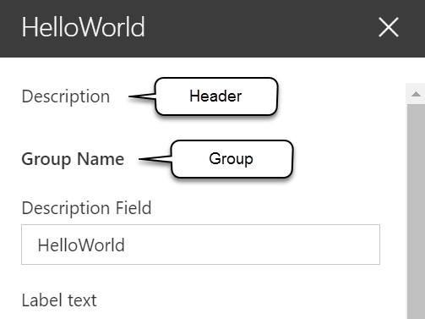
Implementing the header, groups, and fields
protected get getPropertyPaneConfiguration(): IPropertyPaneConfiguration {
return {
pages: [
{
header: {
description: strings.PropertyPaneDescription
},
groups: [
{
groupName: strings.BasicGroupName,
groupFields: [
PropertyPaneTextField('description', {
label: strings.DescriptionFieldLabel
}),
PropertyPaneLabel('labelField', {
text: 'Label text'
})
]
}
]
}
]
};
}

Slide 5
Implementing properties
Define an interface in your web part that includes one or more target properties
Import the corresponding field types in the web part class
Field types are available as modules in the @microsoft/sp-webpart-base library
Modify the default getPropertyPaneConfiguration method and add the properties to the groupFields array

Slide 6
Handling property field changes
The property pane has two interaction modes:
Reactive
Non-reactive
Reactive mode: every change = change event is triggered
Reactive behavior automatically updates the web part user interface with the new property field values
Non-reactive mode: does not update the web part user interface automatically unless the user confirms the changes
While reactive mode is sufficient for many scenarios, at times you will need non-reactive behavior.

Slide 7

Property pane modes
Default mode = reactive mode
Override the default behavior by adding the disableReactivePropertyChanges method to the web part class

Slide 8
Adding configuration properties to React Client-Side web parts
Modify the propertyPaneSettings method and add the property to the groupFields array
protected get propertyPaneSettings(): IPropertyPaneSettings {
return {
pages: [
{
header: {
description: strings.PropertyPaneDescription
},
groups: [
{
groupName: strings.BasicGroupName,
groupFields: [
PropertyPaneTextField('description', {
label: strings.DescriptionFieldLabel
}),

Slide 9
Adding configuration properties to React Client-Side web parts
Pass the property value to React component when the React component is created
public render(): void {
const element: React.ReactElement<IHelloWorldWebPartProps> = React.createElement(HelloWorldComponent, {
description: this.properties.description
});
ReactDom.render(element, this.domElement);
}

Slide 10
Adding configuration properties to React Client-Side web parts
Handle the property values in the React component when the component starts and whenever the property value is updated
public componentDidMount(): void {
this.doSomething(this.props.description);
}
public componentDidUpdate(prevProps: IHelloWorldWebPartProps, prevState: IHelloWorldWebPartState): void {
if (this.props.description !== prevProps.description) {
this.doSomething(this.props.description);
}
}
private doSomething(description: string): void {
// Do something with the property
}

Slide 11
Demo Working with the web part property pane
Notes:
Demo steps:
https://github.com/SharePoint/sp-dev-training-spfx-webpart-proppane/tree/master/Demos/01-proppane

Slide 12

Summary
Overview of Web Part property pane
Implementing custom properties

Slide 13
Working with the Web Part Property Pane
Building custom property pane fields

Slide 14
Introducing the Property Pane
Add custom property pane field
Creating custom property pane controls

Slide 15
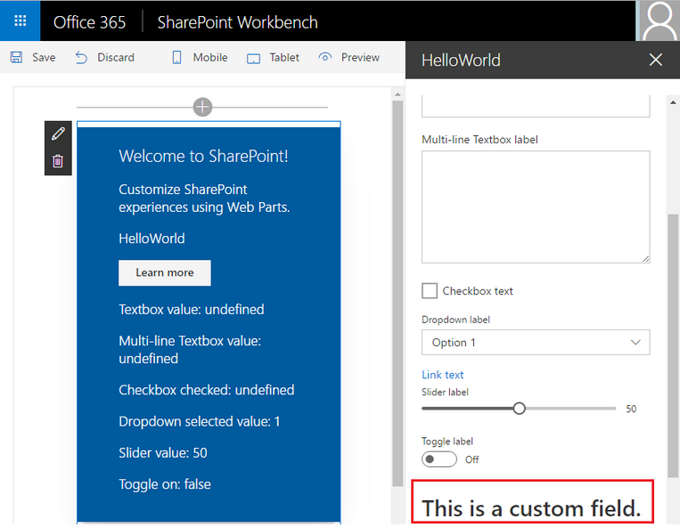
Overview
Property pane supports the following field types out-of-the-box
Label
Textbox
Multi-line Textbox
Checkbox
Dropdown
Link
Slider
Toggle
Custom
Also possible to create your own custom field types

Slide 16
Implementing custom property pane fields
Define an interface in your web part that includes one or more target properties
Import PropertyPaneCustomField field type in the web part class
PropertyPaneCustomField field type is available as a modules in the @microsoft/sp-webpart-base library

Slide 17
Implementing custom property pane fields
// Web Part: create a render method for the custom field
private _customFieldRender(elem: HTMLElement): void {
elem.innerHTML = '<div><h1>This is a custom field.</h1></div>’;
}
// Add custom field definition in a groupFields array
protected get propertyPaneSettings(): IPropertyPaneSettings {
return {
pages: [
{
header: { description: strings.PropertyPaneDescription},
groups: [
{
groupName: strings.BasicGroupName,
groupFields: [
PropertyPaneCustomField('customField', {
onRender: this._customFieldRender.bind(this)
}),
]
} ] } ]
}
}

Slide 18
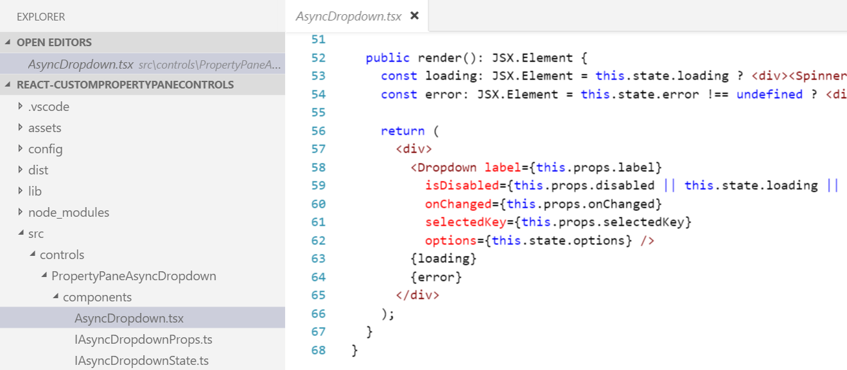
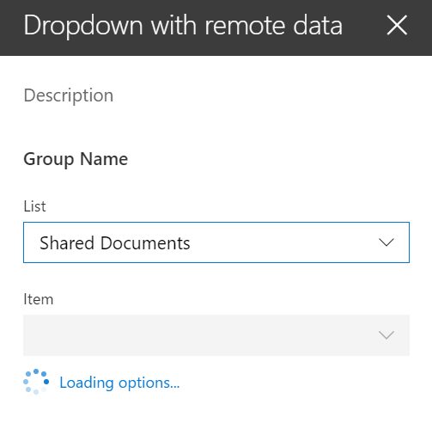
Creating custom property pane controls
When out-of-the-box property pane controls don’t meet your needs you can create your own custom controls
Creating custom controls promotes code reusability
https://github.com/SharePoint/sp-dev-fx-webparts/tree/master/samples/react-custompropertypanecontrols

Slide 19
Demo Building custom property pane fields
Notes:
Demo steps:
https://github.com/SharePoint/sp-dev-training-spfx-webpart-proppane/tree/master/Demos/02-custom-fields

Slide 20
Summary
Add custom property pane field
Creating custom property pane controls

Slide 21
Working with the Web Part Property Pane
Leveraging the SPFx PnP Reusable Property Pane Controls

Slide 22
Introducing the Property Pane
Overview Reusable PnP Controls
Leveraging PnP Controls

Slide 23
Overview
Property pane controls included in SharePoint Framework API are basic input controls
Textbox, drop downs, sliders, toggles, links, lables, etc…
Don’t contain logic or details about current SharePoint site
Simple controls developers can use in web parts
Developers can add logic to initialize them (populate dropdown list with the lists from current site)
Developers can create custom property pane fields with these controls and additional business logic to create “smart controls”

Slide 24
Property Pane Controls for SPFx
Open source community library
Managed by the SharePoint Patterns & Practices(PnP) team
Includes reusable controls with logic tied to existing SharePoint site
https://sharepoint.github.io/sp-dev-fx-property-controls

Slide 25


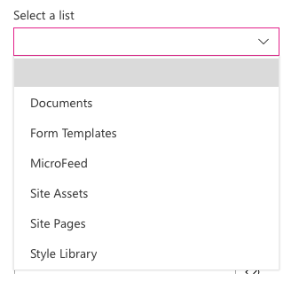
Popular Controls from the PnP Library
PropertyFieldColorPicker
Generates a color picker
PropertyFieldDateTimePicker
Create a datetime picker
PropertyFieldListPicker
Displays dropdown of lists from current SharePoint site
Supports single or multi-select
PropertyFieldPeoplePicker
Lists users & groups from the current SharePoint site
… and many more!

Slide 26
Adding to your project
// install as NPM package
npm install @pnp/spfx-property-controls --save-exact
// import reference in web part
import { PropertyFieldListPicker, PropertyFieldListPickerOrderBy } from '@pnp/spfx-property-controls/lib/PropertyFieldListPicker’;
// add to property pane configuration
PropertyFieldListPicker('lists', {
label: 'Select a list',
selectedList: this.properties.lists,
includeHidden: false,
orderBy: PropertyFieldListPickerOrderBy.Title,
disabled: false,
onPropertyChange: this.onPropertyPaneFieldChanged.bind(this),
properties: this.properties,
context: this.context,
onGetErrorMessage: null,
deferredValidationTime: 0,
key: 'listPickerFieldId'
})
Notes:
npm --save-exact means it will register the exact version you’re downloading in the package.config. No other version will be allowed.

Slide 27
Demo Leveraging the SPFx PnP Reusable Property Pane Controls
Notes:
Demo steps:
https://github.com/SharePoint/sp-dev-training-spfx-webpart-proppane/tree/master/Demos/03-pnp-controls

Slide 28
Summary
Overview Reusable PnP Controls
Leveraging PnP Controls

Slide 29
Reading further
Overview of the SharePoint Framework
https://docs.microsoft.com/sharepoint/dev/spfx/sharepoint-framework-overview
Make your SharePoint client-side web part configurable
https://docs.microsoft.com/sharepoint/dev/spfx/web-parts/basics/integrate-with-property-pane
Validate Properties
https://docs.microsoft.com/sharepoint/dev/spfx/web-parts/guidance/validate-web-part-property-values

Slide 30
Reading further
Overview of the SharePoint Framework
https://docs.microsoft.com/sharepoint/dev/spfx/sharepoint-framework-overview
Make your SharePoint Client-Side Web Part Configurable
https://docs.microsoft.com/sharepoint/dev/spfx/web-parts/basics/integrate-with-property-pane
Build Custom Controls for the Property Pane
https://docs.microsoft.com/sharepoint/dev/spfx/web-parts/guidance/build-custom-property-pane-controls

Slide 31
Reading further
Overview of the SharePoint Framework
https://docs.microsoft.com/sharepoint/dev/spfx/sharepoint-framework-overview
Make your SharePoint Client-Side Web Part Configurable
https://docs.microsoft.com/sharepoint/dev/spfx/web-parts/basics/integrate-with-property-pane
Reusable Property Panel Controls for SharePoint Framework Solutions
https://sharepoint.github.io/sp-dev-fx-property-controls/

Slide 32
Lab In this lab you work with the SharePoint Framework (SPFx) to extend client-side web parts using the property pane. aka.ms/spdevwsM4L3
Notes:
Lab manual at:
https://aka.ms/spdevwsm4l3

